Slide 1

Keyloggers project
Presented by,
P.Angel,
3rd year computer science and engineering ,
Universal college of engineering and technology.

Slide 2
Outline
Keyloggers definition
Keyloggers use
Type of keylogger
Problem statement
Result
Conclusion

Slide 3
Keyloggers definition
A keylogger or keystroke logger/keyboard capturing is a form of malware or hardware that keeps track of and records your keystrokes as you type.
It takes the information and sends it to a hacker using a command-and-control (C&C) server.

Slide 4
Types of keyloggers
Hardware
keylogger or keystroke logger/keyboard capturing is a form of malware or hardware that keeps track of and records your keystrokes as you type.
It takes the information and sends it to a hacker using a command-and-control (C&C) server.
Software
There are two main types of software keyloggers: User mode keyloggers use a Windows application programming interface (API) to intercept keyboard and mouse movements.
GetAsyncKeyState or GetKeyState API functions might also be captured. These keyloggers require the attacker to actively monitor each key press.

Slide 5
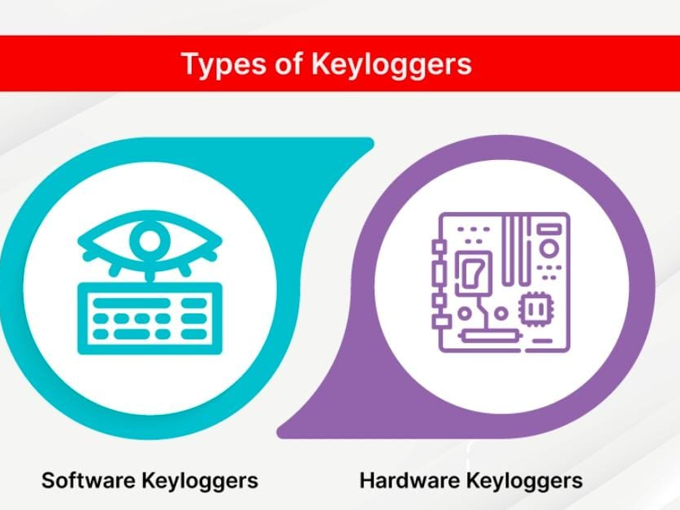

Slide 6
Use of keyloggers
Here are some common legitimate uses for keyloggers: IT troubleshooting — to collect details on user problems and resolve accurately.
Computer product development — to gather user feedback and improve products.
Business server monitoring — to watch for unauthorized user activity on web servers.

Slide 7
Problem statement
Keyloggers are a genuine danger to clients and the clients' information, which is considered exploitative movement.
The problem statement is that the keyloggers can be detected using antiviruses.
Installation of hardware keyloggers is difficult without the knowledge of the owner of the system.

Slide 8
Result
Type of spyware that records keyboard inputs and sends that information back to the person controlling it.
Keystroke logging (or keystroke capturing) records everything you type — including passwords, account information, emails, searches, and personal information.

Slide 9
Conclusion
Keyloggers are a potent threat to both individuals and enterprises, with the potential to cause significant harm if left undetected.
Understanding the nature of keyloggers, their methods of infiltration, and the dangers they pose is crucial for maintaining a secure digital environment.

Slide 10
Thank you

